Slide 1

SQL Portfolio Project using Google Big query and Google Data studio (Aka) Looker.
SALAI ARUN MANI J B
https://www.linkedin.com/in/salaiarunmanijb/ #salaiarunmanijb

Slide 2

Google Big-Query
BigQuery is a fully managed enterprise data warehouse that helps you manage and analyze your data with built-in features like machine learning, geospatial analysis, and business intelligence. BigQuery's serverless architecture lets you use SQL queries to answer your organization's biggest questions with zero infrastructure management. BigQuery's scalable, distributed analysis engine lets you query terabytes in seconds and petabytes in minutes.
Source: https://cloud.google.com/bigquery/docs/sandbox

Slide 3


Looker (aka) Google Data studio
Just as Google organizes the world’s information and makes it universally accessible and useful, Looker does the same for your business data, making it easy to build insight-powered workflows and applications. Looker is basically a Business Intelligence tools
Source : https://cloud.google.com/looker

Slide 4
Big Query sandbox : https://cloud.google.com/bigquery/docs/sandbox
Free
Free
Free
Free
Free
Free

Slide 5
We have to Create
Project
Dataset
Table

Slide 6

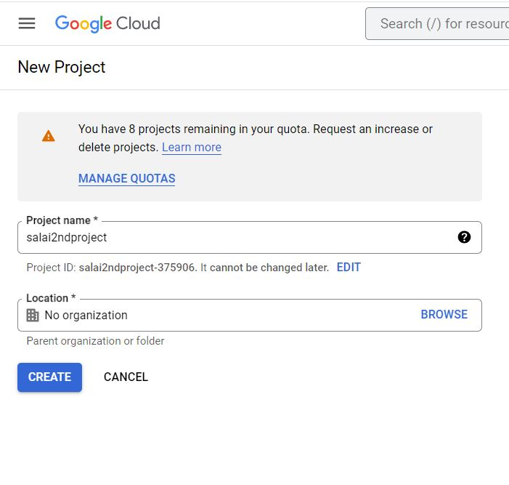
Step 1 : First we have to Create new project in Google cloud
Project creation
Step 2: Name the project

Slide 7
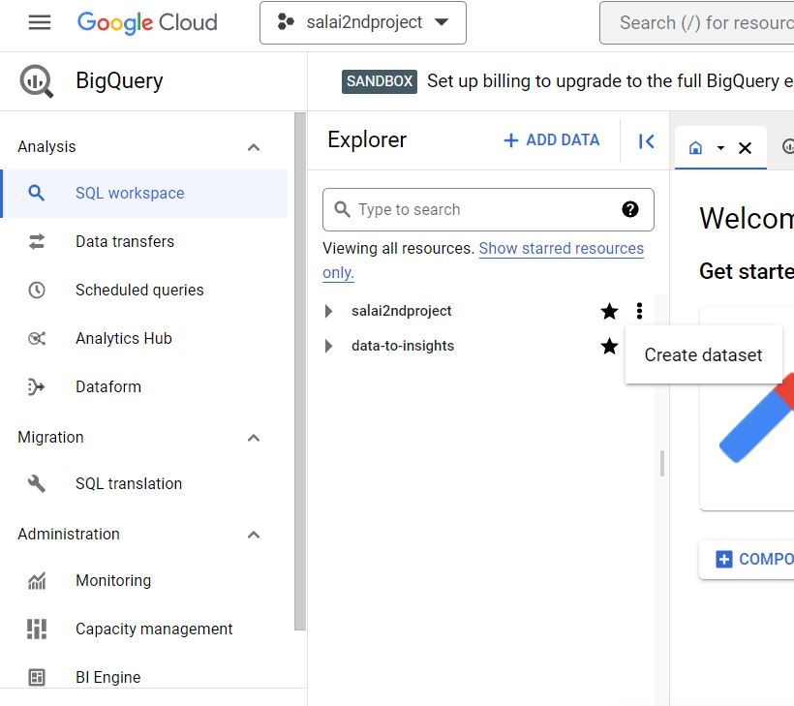
Step 1: Create Dataset
Dataset creation

Slide 8
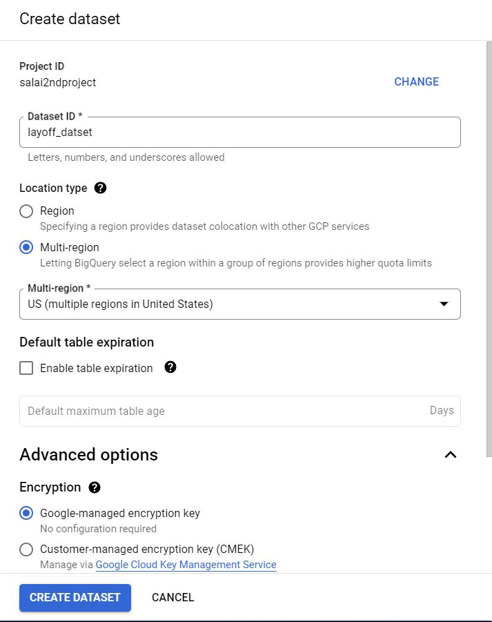
Step 2 : Give the dataset id Step 3 : click create dataset

Slide 9
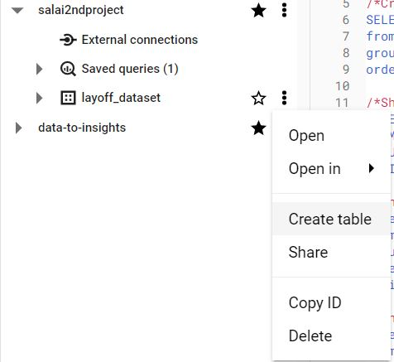
Step 1 : Create table
Table Creation

Slide 10
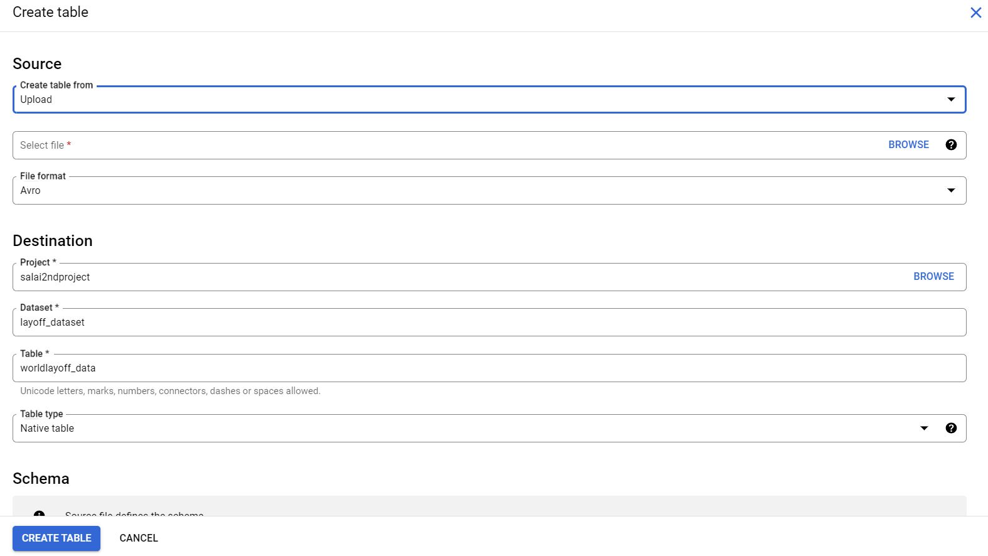
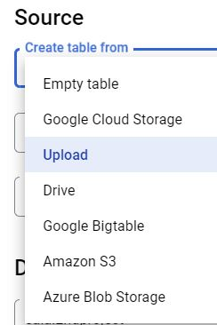
Step 2 : select the table from(Here upload (CSV file) Step 3:browse the file and upload it Step 4:Name the table

Slide 11
Step 5: click the advanced options

Slide 12
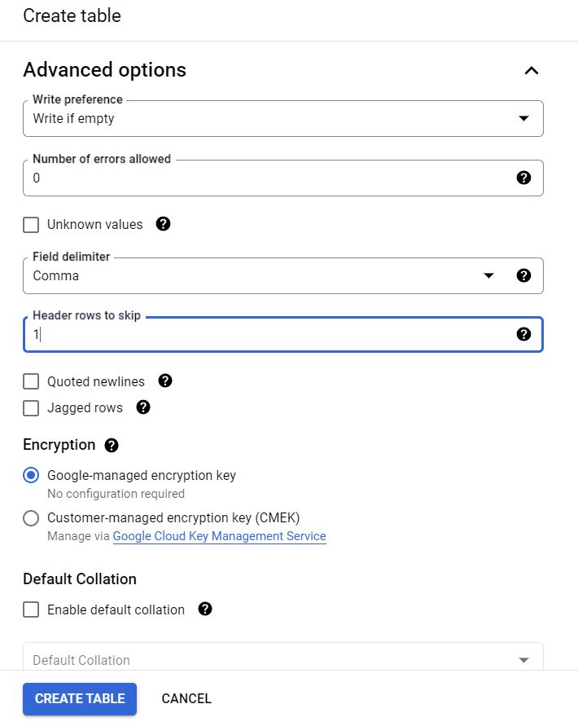
Step 6: In Header rows to skip 1 (by default it is 0) Step 7: click Create Table

Slide 13
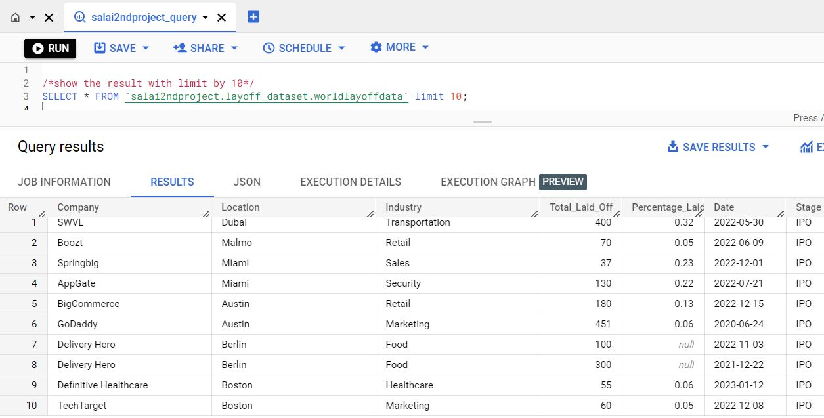
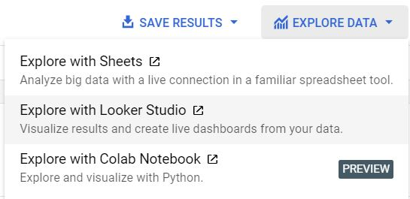
Show the result with limit by 10
Salai2ndproject – Project Name
Layoff_dataset – Dataset name
Worldlayoffdata – Table name

Slide 14
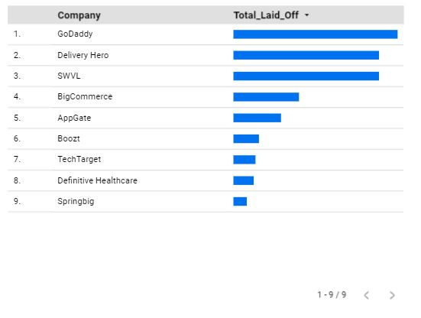
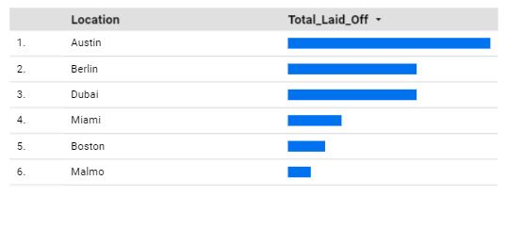
Show the result with limit by 10

Slide 15
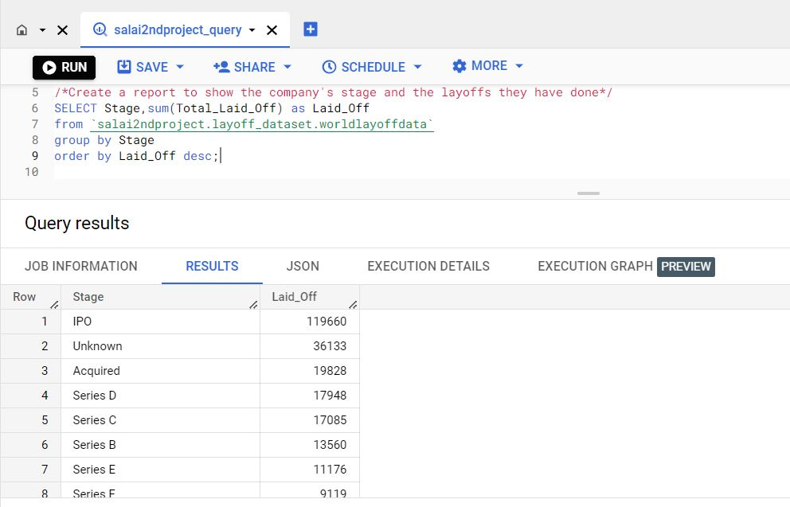
Create a report to show the company’s stage and the layoffs they have done.

Slide 16
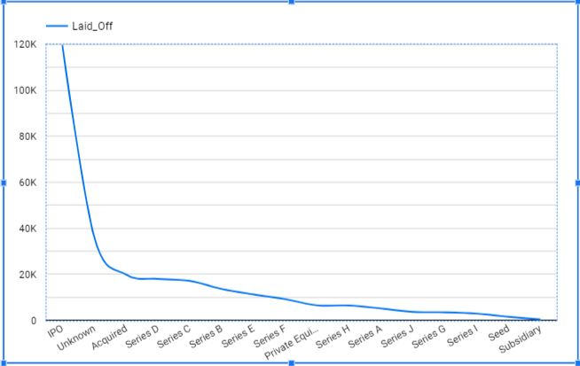
Create a report to show the company’s stage and the layoffs they have done.

Slide 17
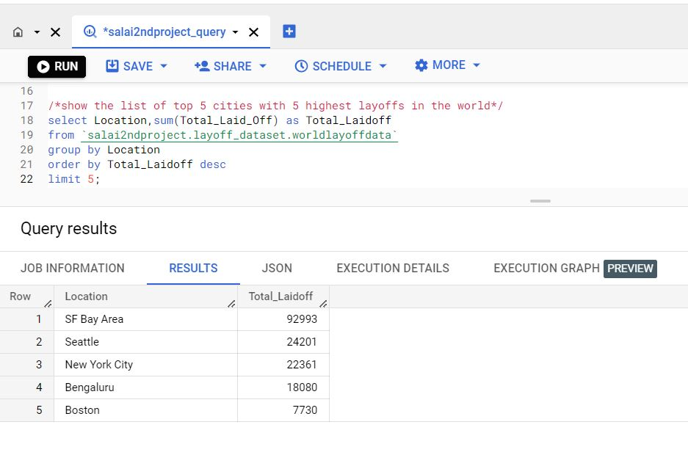
Show the list of top 5 cities with 5 highest layoff’s in the world.

Slide 18
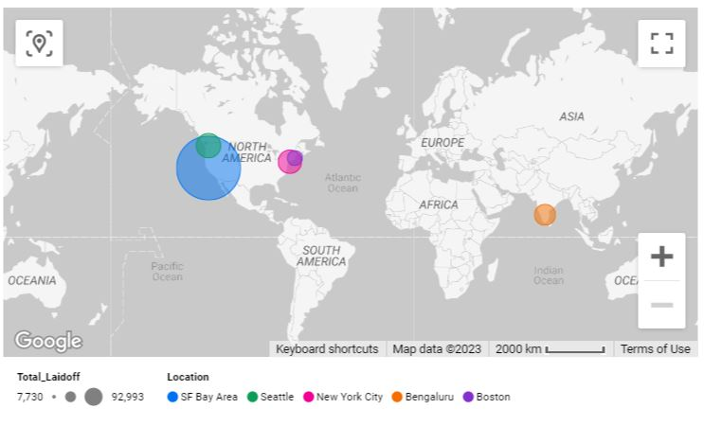
Show the list of top 5 cities with 5 highest layoff’s in the world.

Slide 19
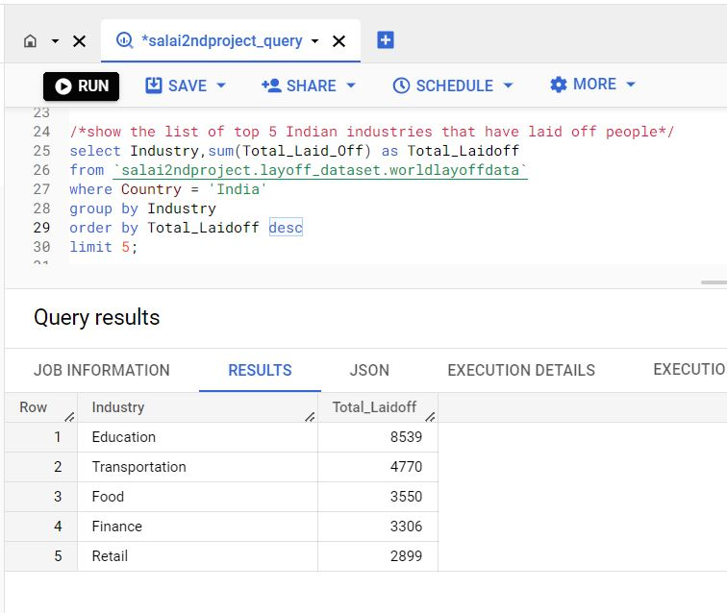
Show the list of top 5 Indian industries that have laid off people.

Slide 20
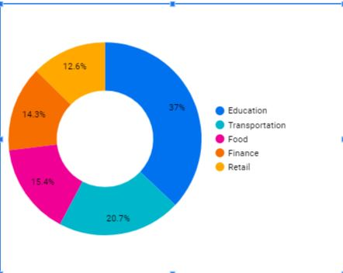
Show the list of top 5 Indian industries that have laid off people.

Slide 21
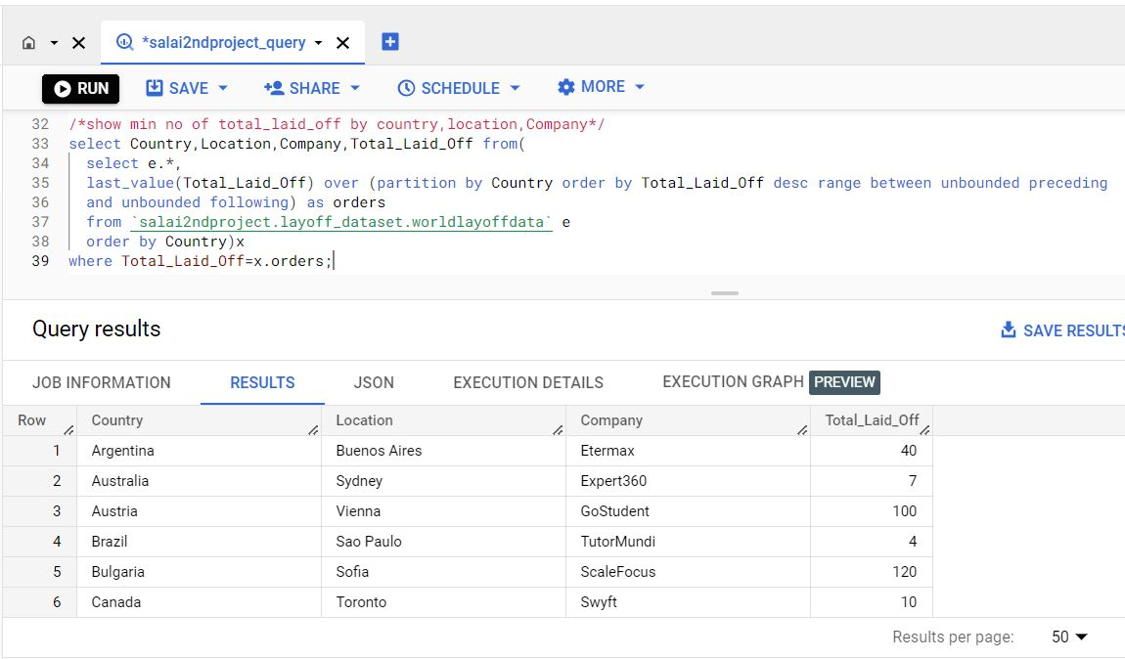
Show min no of Total laid off by country,location,company

Slide 22
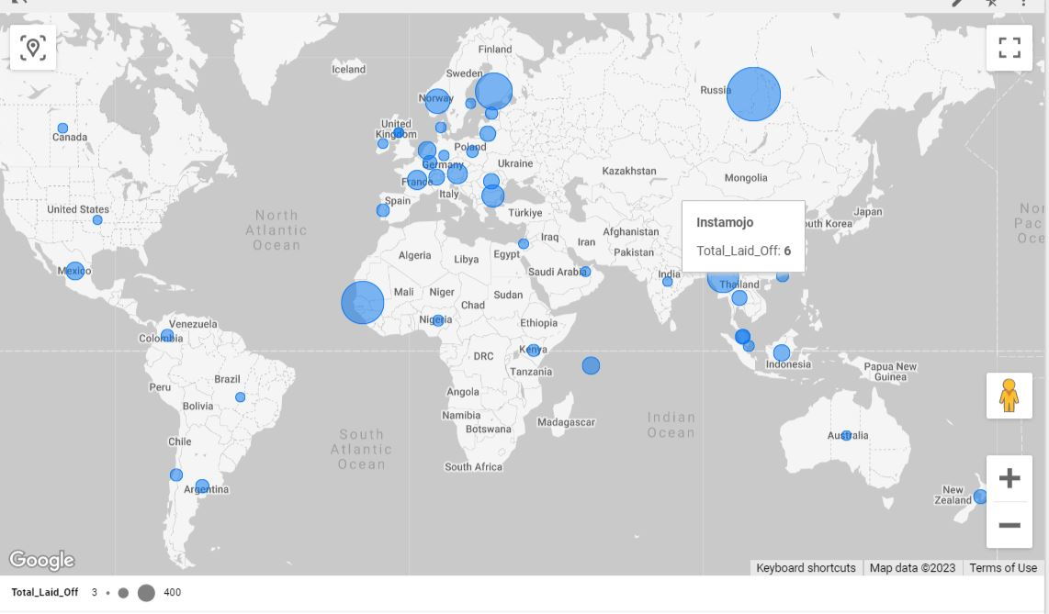
Show min no of Total laid off by country,location,company

Slide 23
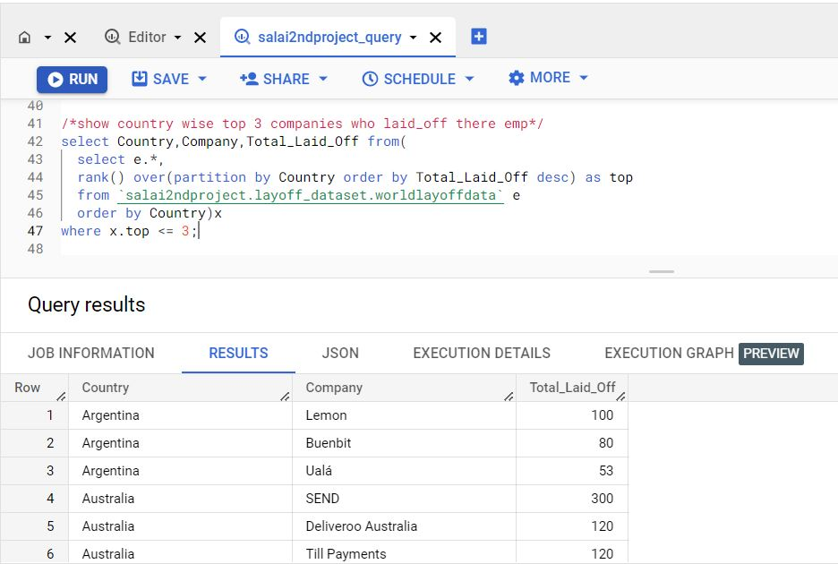
Show country wise top 3 companies who laidoff there emp.

Slide 24
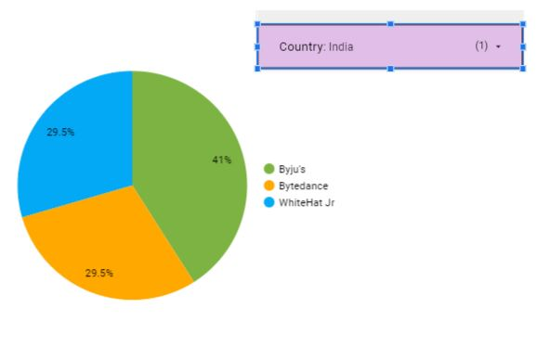
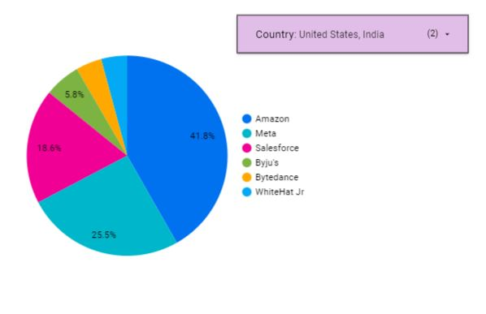
Show country wise top 3 companies who laid off there emp.

Slide 25
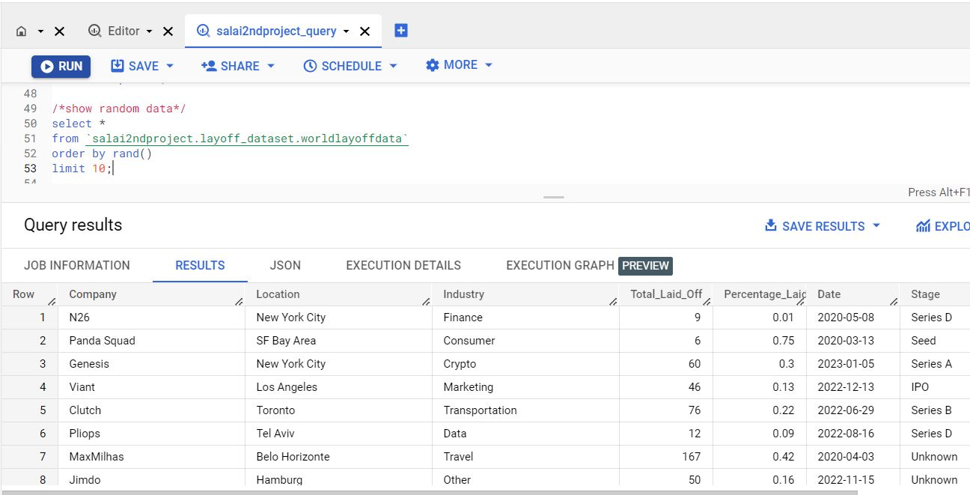
Show the random data from dataset.

Slide 26
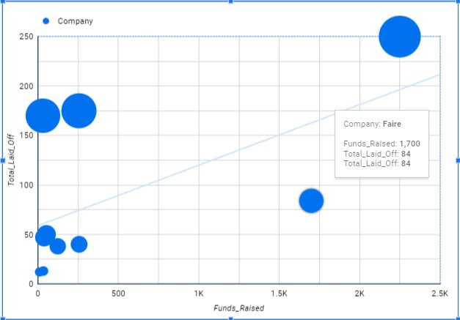
Show the random data from dataset.

Slide 27
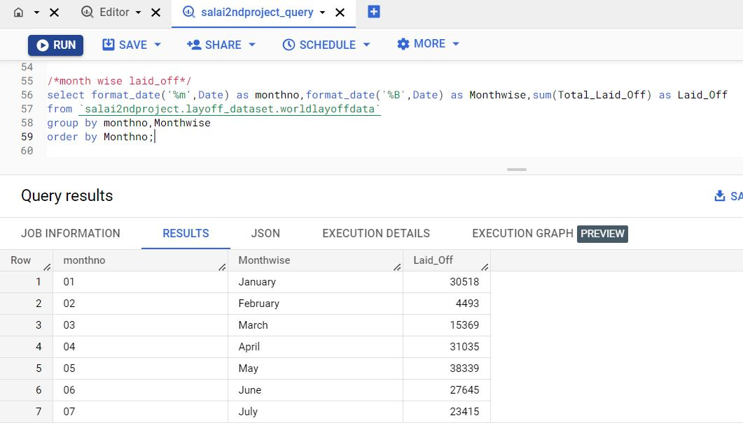
Show month wise lay off.

Slide 28
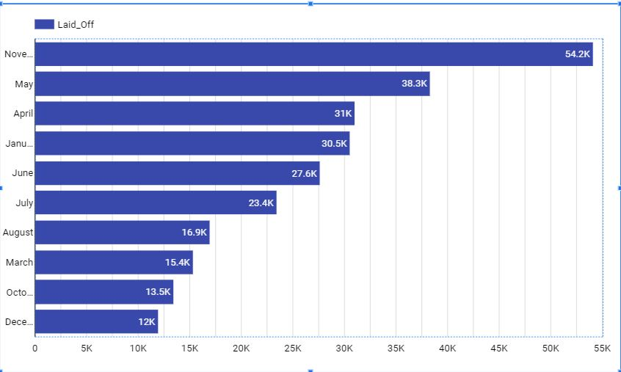
Show month wise lay off.

Slide 29
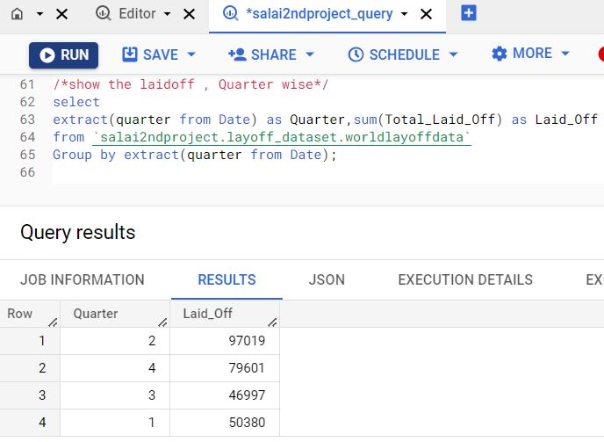
Show Quarter wise layoffs

Slide 30
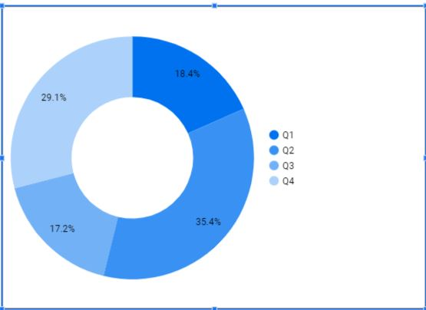
Show month wise lay off.

